Slide 1
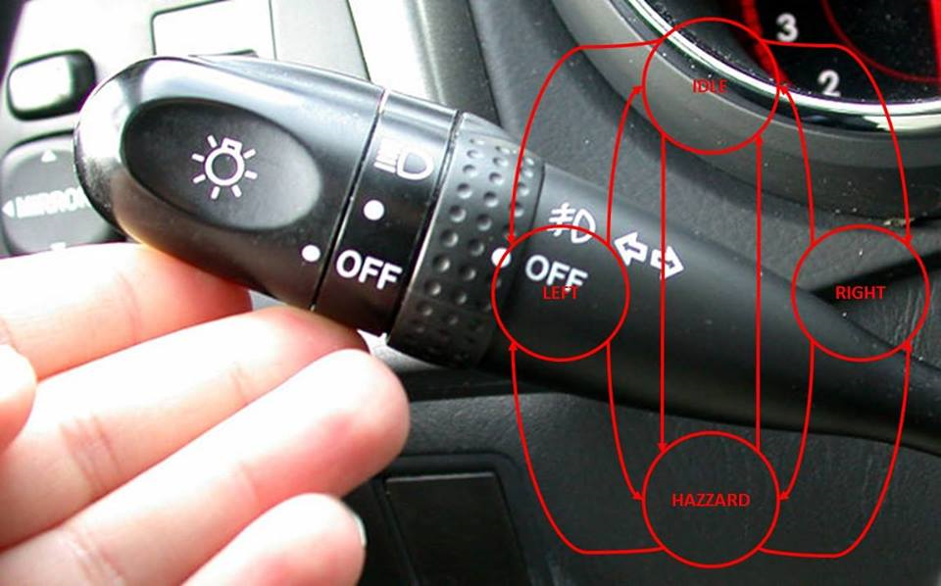
Embedded SW Design

Slide 2
Objectives
Understanding embedded software design and its different aspects
Learn about scalable fundamentals techniques/tools for embedded software design
Design and Implement software on small µ-controllers

Slide 3
Prerequisite(s)
Programming in any high-level programming language preferably C
Knowledge of µ-controller programming is a plus

Slide 4
Notes
Ask any time.
Cell phones silent, please!
Certificates are not for attendance.

Slide 5


Reference(s)
The slides are compilation of books below.

Slide 6
Outline
Introduction to SW Design
SW Communication Patterns
State Machine Patterns
Multitasking Forms
The 674 Embedded SW Design Process
Static Design
Dynamic Design
Case Study
Industrial Project

Slide 7
Outline
Introduction to SW Design
SW Communication Patterns
State Machine Patterns
Multitasking Forms
The 674 Embedded SW Design Process
Static Design
Dynamic Design
Case Study
Industrial Project

Slide 8
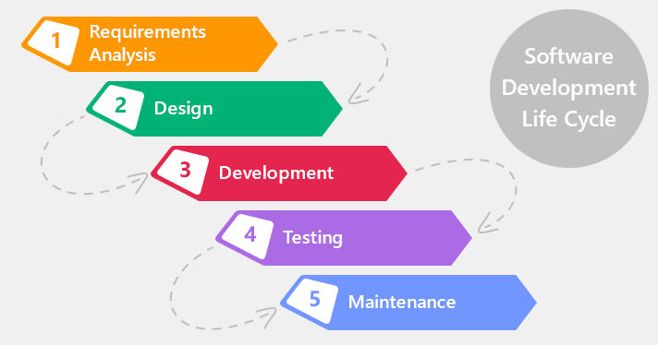
SW Development Phases
Notes:
Requirement = Problem + Solution Statement
Design = How to build the solution [Solution can be built using many ways] (Options, criteria)
Development = Building the solution
Testing = Verify The solution
Maintain = Systems corrections in the field
(Q-Galal) What is Problem with This Way ? (Look For Alternative [V-Model])

Slide 9
Software Design
Similar to real-time
Static = correct func
Dynamic = correct time
System/SW
Requirement Specification
Static Design
Dynamic Design
Software Design
Design Document
Context diagram
Document
Or
.c and .h Skeletons
Doxygen
graphize
Notes:
Design Documents could be [Graphs, Text File] [.h , Skeleton.c] files
What is first [Static or Dynamic] ?

Slide 10
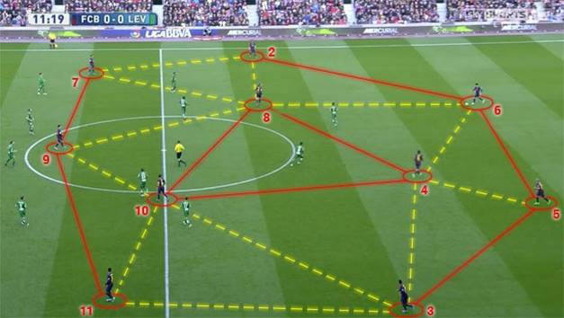
Static Design vs. Dynamic Design
Notes:
(Q-Galal) what do you understand from this shape ?
Static Design = Structure = Modules [Building Blocks] + Connection
Dynamic Design = interaction
Real Time System = correct function @ Correct Time
Static Design = Correct Function
Dynamic Design = Correct Time

Slide 11
C/C’s of Good SW Design
Correct
Maintainable
Understandable
Correct:
When meets the req.s
Doing nothing wrong
Doing nothing extra
Understandable to others correctly and the design has no more than one meaning
-Can edit and correct any problem without affecting any other modules
-Abstract and less coupling
Use a process or a template or a review
Notes:
Correct = Covers the requirements. Nothing is missing nor unnecessary is added.
Understandable = Standardized by process and template and can only have one interpretation. Achieve It Using [Process + Template + Review]
Maintainable = Easy to change (High cohesion and Loose coupling)

Slide 12
Software Design Levels
System
Sub-System <<1>>
Sub-System <<2>>
Sub-System <<n>>
Module <<1>>
Module <<2>>
Module <<m>>
Sub-Module <<1>>
Sub-Module <<2>>
Sub-Module <<z>>
Notes:
Don't be afraid of Big Projects or Systems [divide and conquer]
System = 1 or More Sub-System
Sub-System = 1 or More Module
Module = 1 or More Sub-Module

Slide 13
Software Design Levels _{cont’d}
What is a minimal system?
What is architecture design/high-level design?
What is detailed design/low-level design?
What are the tangible outputs of every design level?
Stop when you know and design the module level
Notes:
What is a minimal system?
Determined by system size and complexity
A system can be made of 1 sub-system.
A subsystem can be made of 1 component.
A component can be made of 1 sub-component.
What is architecture design?
Starts at breaking down the system into sub-systems
Where it ends?
What is detailed design?
Ends at the sub-components
Where it starts?
What are the tangible outputs of every design level?
Documents and/or code skeleton

Slide 14
Exercise: Mapping Design Outputs to C Code
Design Output
C Code
System
Sub-system
Module
Sub-Module
1 C file and 1 or more header files
IDE project
Data types, variables, functions and constants
Group of files (in a folder may be)
اللى عنده سيستم احسن من اللى ماعندهوش..حتى لو غلط, فالسيستم بيصلح نفسه بنفسه
Notes:
1-B
2-D
3-A
4-C

Slide 15
A Module = 1 or More Function
From static design point of view, a module should have:
1 Initialization function
Initializes HW
Initializes data structures
Initializes both
1 or more Update functions
Update something
Do the module logic
0 or more setter functions
Set something in the module
0 or more getter functions
Get something from the module
Watch-dog = init + update only

Slide 16
A Module = 1 or More Function
MOD_Init(…)
Setters sets one value at a time
Getters gives one
value at a time
Module
MOD_SetSomething(…)
MOD_GetSomething(…)
void MOD_UpdateSomething(void)

Slide 17
A Push Button Module
If the driver/module works with multiple instances, then the function will need to differentiate between them so use a parameter for that
void PB_Init(tPB pb, tPB_State state)
Push Button
tPB_State PB_GetState(tPB pb)
u16 PB_GetPressTimeMS(tPB pb)
For every getter, it’s better to have a parameter in the initialization function otherwise, a default will be used
void PB_UpdateState(void)
void PB_UpdatePressTimeMS(void)
Notes:
Where Is Setter ? (Because It is Read Hardware )

Slide 18
A Module = 1 or More Function – Revisited
From dynamic design point of view, we classify module functions into:
Initialization: Called once before module usage most probably during initialization
Task: Period or Aperiodic and called by the OS
ISR: Periodic or Aperiodic and called by the HW
Function: Is not one of the above types and can be called from any other function
Isr if the event is faster than the os
The function has no time properties and it’s called from init/task/isr

Slide 19
Exercise: Function Classification
Static Design
Dynamic Design
Initialization
Update
Setter
Getter
Initialization
Task
ISR
Function

Slide 20
A Push Button Module – Revisited
PB_Init is an initialization function
PB_UpdateState can be a task or ISR
PB_UpdatePressTimeMS is a task
PB_GetState is a function
PB_GetPressTimeMS is a function

Slide 21
Assignment 1: Module
Please identify and classify the functions of the following modules:
Seven Segment Display driver that controls multiple seven segment displays
HW timer

Slide 22
Outline
Introduction to SW Design
SW Communication Patterns
State Machine Patterns
Multitasking Forms
The 674 Embedded SW Design Process
Static Design
Dynamic Design
Case Study
Industrial Project

Slide 23
We are Talking about
M1_GetSomething
Implemented in M1 and called in M2
M2_SetSomething
Implemented in M2 and called in M1
M1_GetSomething (…)
OR
M2_SetSomething(…)
Module 1
Module 2

Slide 24

Communication Protocols
Instructions to perform communication between senders and receivers
Inter-task communication problems mainly are:
Sender is not ready
Receiver is not ready
Both are ready and operating @ different rates

Slide 25

Simple Data Broadcast Protocol (Asynchronous)
Instructions
Sender continuously posts most recent data to a global storage.
Receiver retrieves latest data when needed.
When to use
Data does need to include event information and/or
Data is meaningful when combined with other events.
No handshaking
Notes:
Broadcast = No History + No Acknowledge
System Stuck in Sender Failure

Slide 26
Simple Data Broadcast Protocol (Asynchronous) _{cont’d}
Limitations
Sender must complete any data update before receiver is allowed to read data.
Receiver will have to wait for a flag or tolerate partially updated data.

Slide 27

Semaphore Protocol (Synchronous)
AKA event-driven single transfer
Instructions
Sender checks for last transfer completion and waits if not.
Sender posts recent data to a global storage.
Sender indicates new data by a flag.
Sender can wait for flag or continue with other activities.
Receiver checks the flag and receives data if needed.
After reception, receiver changes flag sate.
When to use
Event information is needed and may not include data information.
Handshaking is needed.
Notes:
Semaphore = Broadcast + flag
Semaphore = History + Acknowledge
System Stuck in Receiver Failure

Slide 28
Semaphore Protocol (Synchronous) _{cont’d}
Limitations
Sender may idle waiting for receiver to complete reception.
@ the initial check or after sending
Initial check is it really needed?

Slide 29
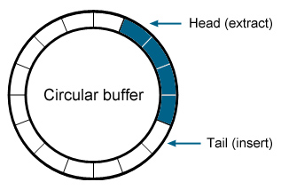
Buffer Protocol (Asynchronous)
AKA event-driven multielement transfer or message queuing
Instructions
Sender checks if buffer is full.
Sender posts recent data to buffer first empty location end if not full.
Sender can check receiver status.
Receiver checks if buffer not empty.
Receiver retrieves oldest data from buffer.
Notes:
Buffer = History + No Acknowledge

Slide 30
Buffer Protocol (Asynchronous) _{cont’d}
When to use
Event information is needed and may not include data information.
Sender and receiver operate @ different rates.
Handshaking is needed.
Limitations
Indices needed for writing and reading.
Handshaking is indirect through buffer.
Wrap around nature in case of circular buffers

Slide 31
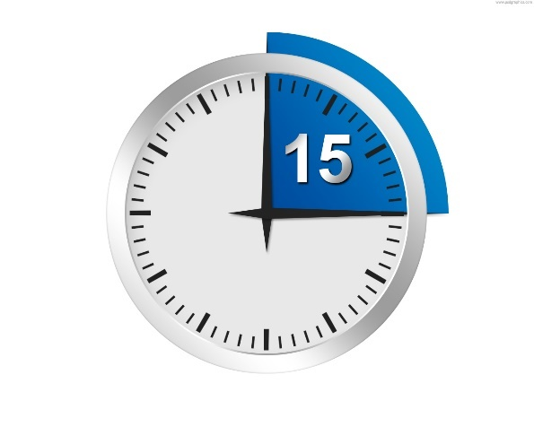
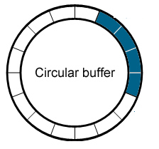
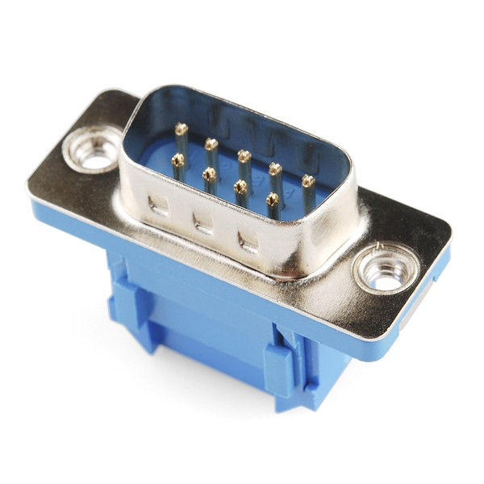
Exercise: Identify Communication Protocols
Rx Task
ISR

Slide 32
Assignment 2: SW Communication Patterns
For every SW communication pattern, please write the following C functions:
Send
Receive
Notes:
Req : SW + Monitor [SW – State]
Broad Cast : Monitor_Update -> Call -> SW_GetState() -> Doesn’t contain any flag
Semaphore : Monitor_Update -> Call -> SW_GetState() -> contains flag
Buffer : SW_Update -> Call -> Monitor_SetSwState() which contains speed

Slide 33
Outline
Introduction to SW Design
SW Communication Patterns
State Machine Patterns
Multitasking Forms
The 674 Embedded SW Design Process
Static Design
Dynamic Design
Case Study
Industrial Project

Slide 34
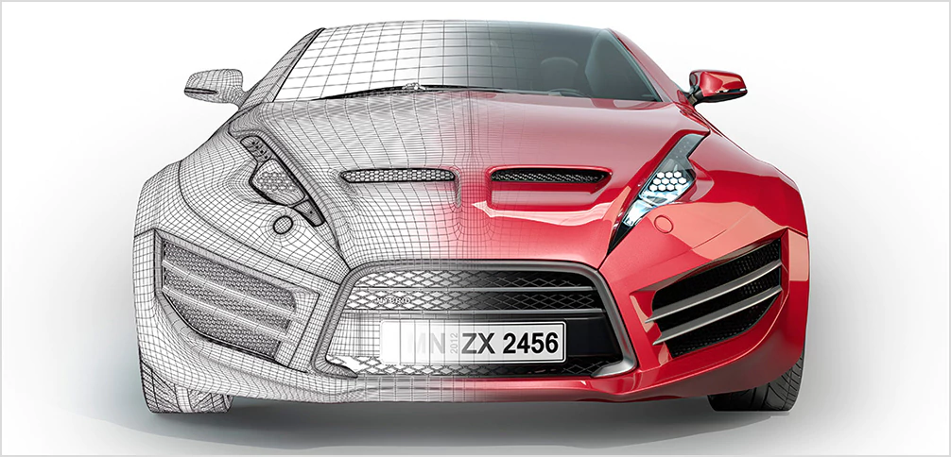
What is a State Machine?
Notes:
SM is a Model[Graph,Table,Equation]
Model = Abstract
SM Used to get the behaviour of Update Function

Slide 35
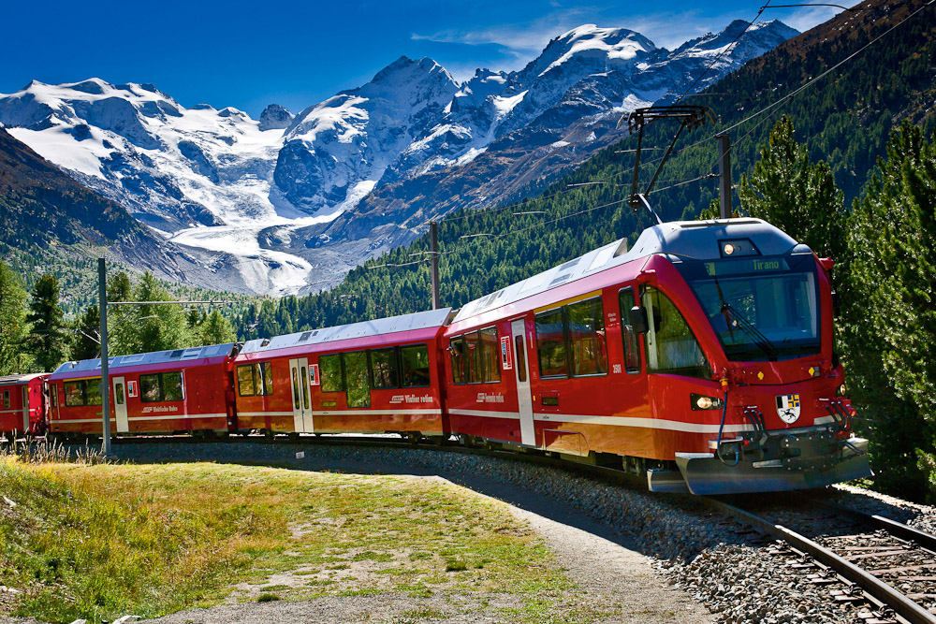
Why a State Machine?
Notes:
SM is a systematic way for (Design + Code + Testing)

Slide 36
State Machine Elements
S/M Elements
States
Transitions
Events
Actions

Slide 37
States are ...
States
Finite
Distinct
1 or more initial states
0 or more end states
0 or more intermediate states

Slide 38
State Machine Graphical Representation
Play/Song is Playing from beginning
Stopped
Playing
Stop or Song Finished/Song is Stopped
Play/Song is Resumed
Stop/Song is Stopped
Paused
Pause/Song is Paused
Notes:
What if an event is causing an action without a state transition? There are 2 ways.

Slide 39
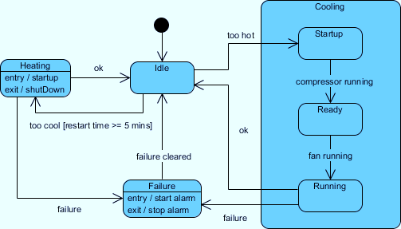
State Machines are Hierarchical

Slide 40
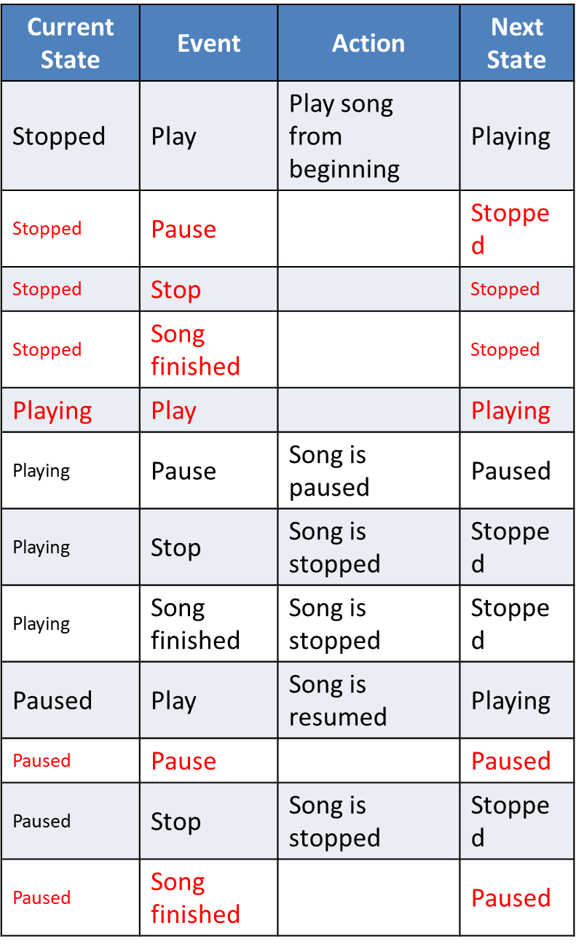
State Machine Tabular Representation
Notes:
Rows = (States * Events) + 1

Slide 41

State Machines are Concurrent

Slide 42

State Machine Textual Representation

Slide 43
State Machine from Design PoV
Events
Timing events only?
Input events only?
Timing and input events

Slide 44
State Machine from Coding PoV
Similar?
Different?
1 function + Data
State type + State variable + function (switch-case) + function for every state (optional)

Slide 45

Execution-Indexed State Machine Example
Notes:
SM Types = Execution Indexed or Data Indexed
Execution Indexed = State Type + State Variable + function with Switch Case + 1 Function for Each State (optional)
Data Indexed =

Slide 46
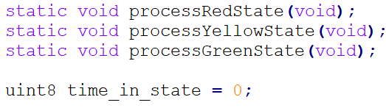
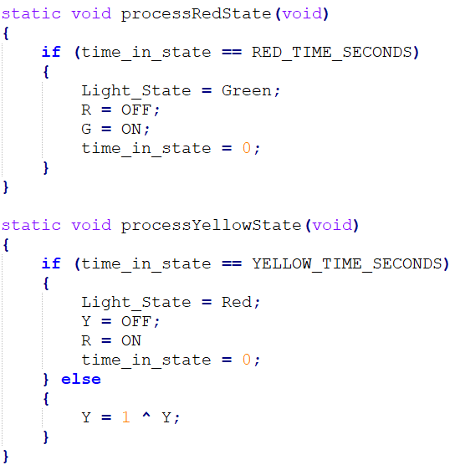
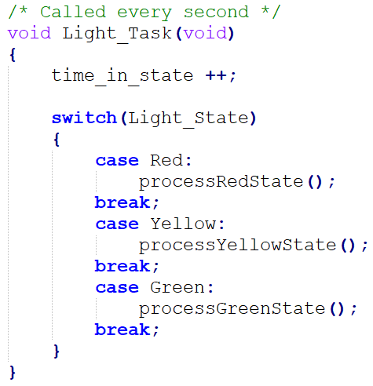
Execution-Indexed State Machine Example _{cont’d}

Slide 47
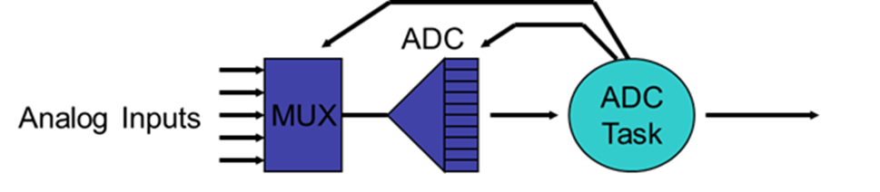
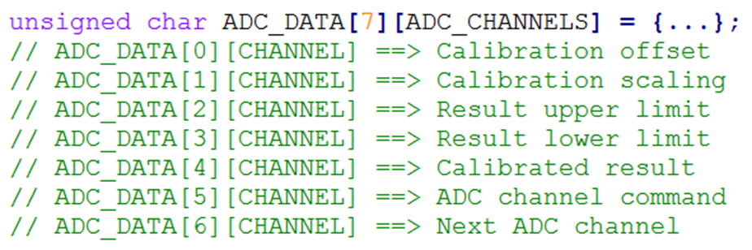
Data-Indexed State Machine Example

Slide 48
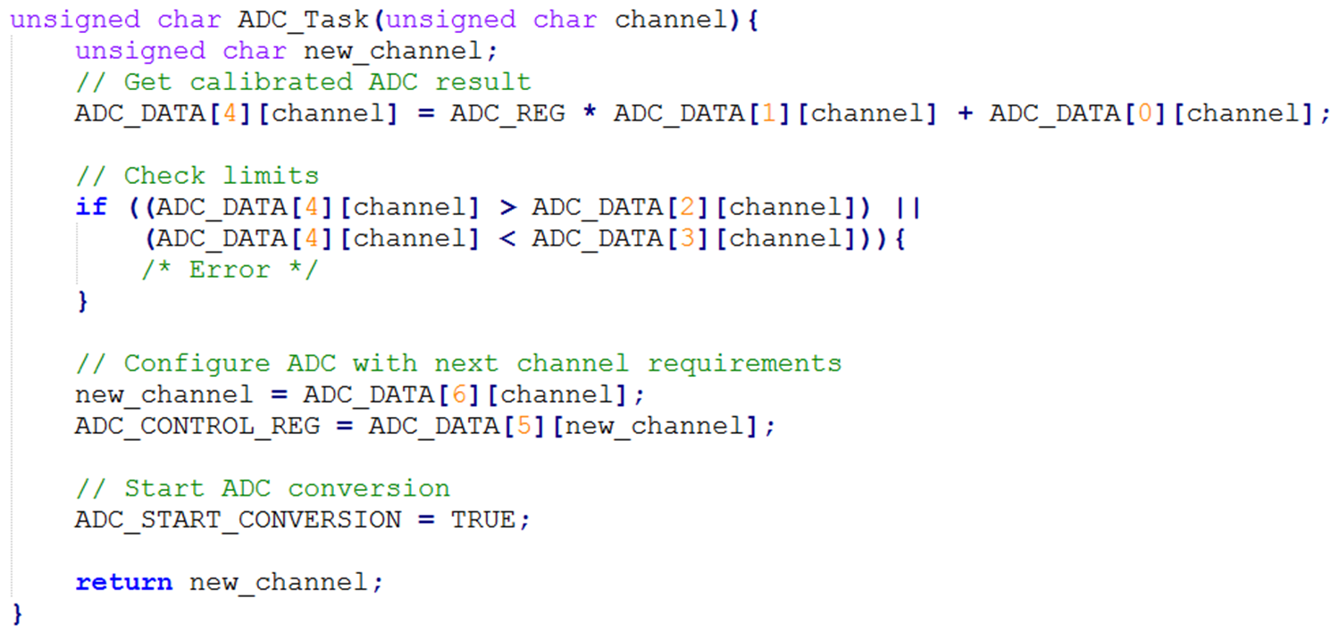
Data-Indexed State Machine Example _{cont’d}

Slide 49
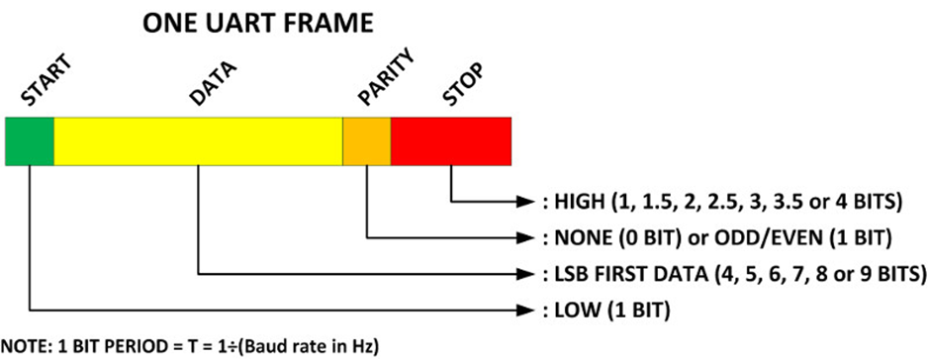
Remember: State Machines are Hierarchical

Slide 50
UART Transmitter
0
1
n
Start
Data
Idle
Parity
Stop

Slide 51
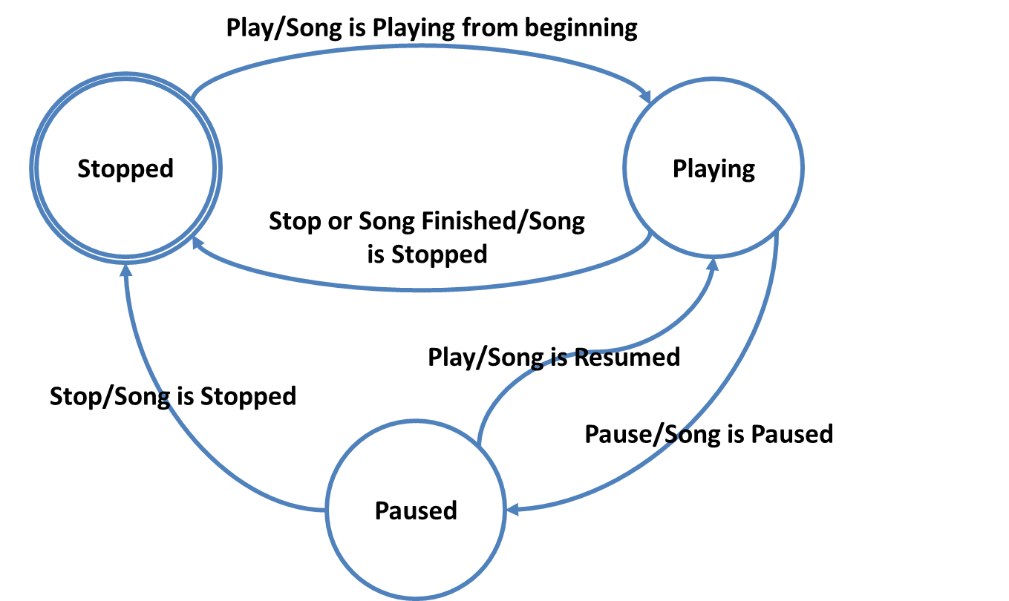
Testing State Machine – Coverage Methods
States
Events
Actions
Paths

Slide 52
Testing State Machine – Coverage Methods _{cont’d}
States
Events
Actions
Paths

Slide 53
Testing State Machine – Coverage Methods _{cont’d}
States
Events
Actions
Paths

Slide 54
Testing State Machine – Coverage Methods _{cont’d}
States
Events
Actions
Paths

Slide 55
Transition Coverage: n-switch (+ve Testing)
3
B
D
9
13
10
11
5
1
8
A
C
12
E
14
4
2
F
6
7

Slide 56
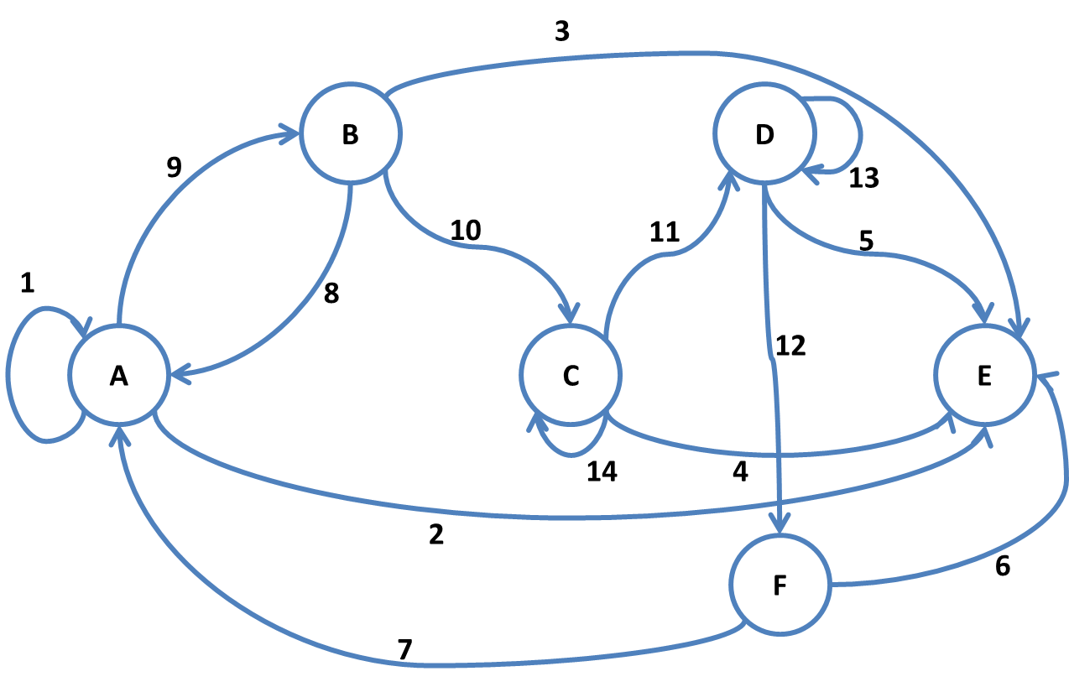
Transition Coverage: 0-switch vs. 1-switch
0-switch |  |  | 1-switch
A1 | A2 | A9 | A1A1 | A1A2 | A1A9 |  |  |  | A9B10 | A9B8 | A9B3
B10 | B8 | B3 | B10C14 | B10C11 | B10C4 | B8A1 | B8A2 | B8A9
C14 | C11 | C4 | C14C14 | C14C11 | C14C4 | C11D13 | C11D12 | C11D5
D13 | D12 | D5 | D13D13 | D13D12 | D13D5 | D12F6 | D12F7
F6 | F7 |  |  |  |  | F7A1 | F7A2 | F7A9

Slide 57
0-switch: Systematic Way
1
3
3
4
1
2
2
1
2
1
3
1
3
1
4
2
1

Slide 58
n-switch: Systematic Way
(N-1)-switch
Extra level in the tree
N-switch

Slide 59
-ve Testing
-ve Testing
Testing Invalid Transitions

Slide 60
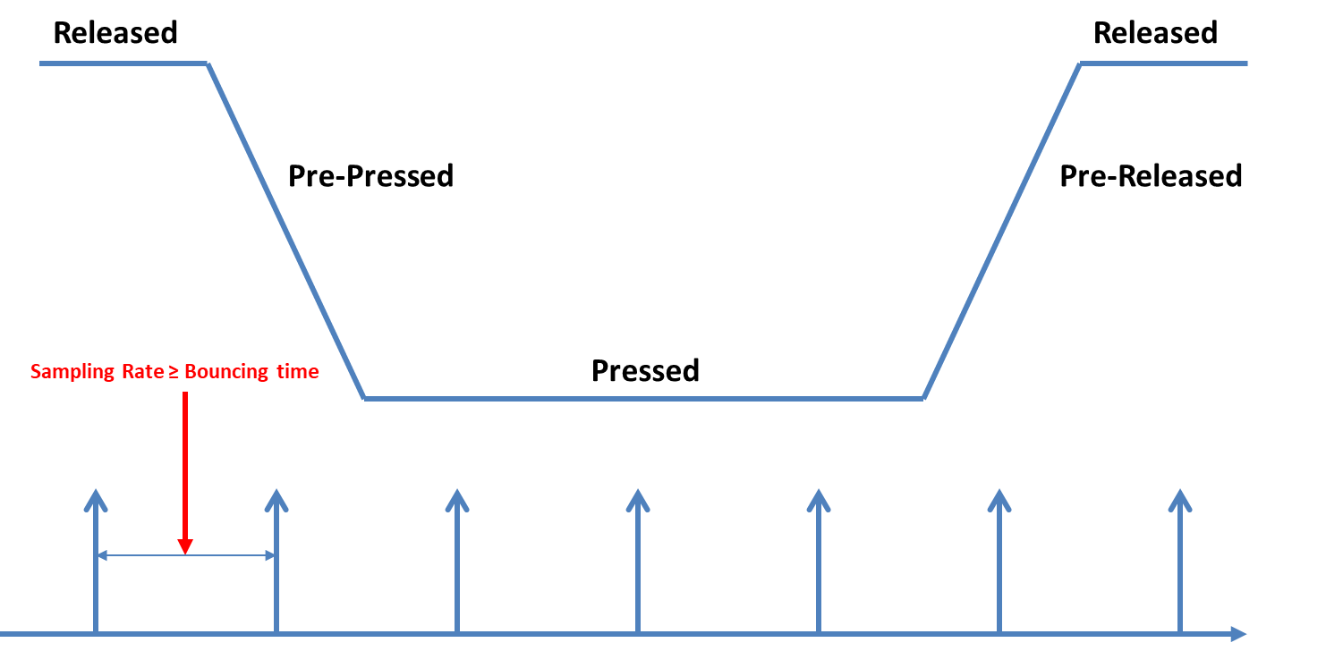
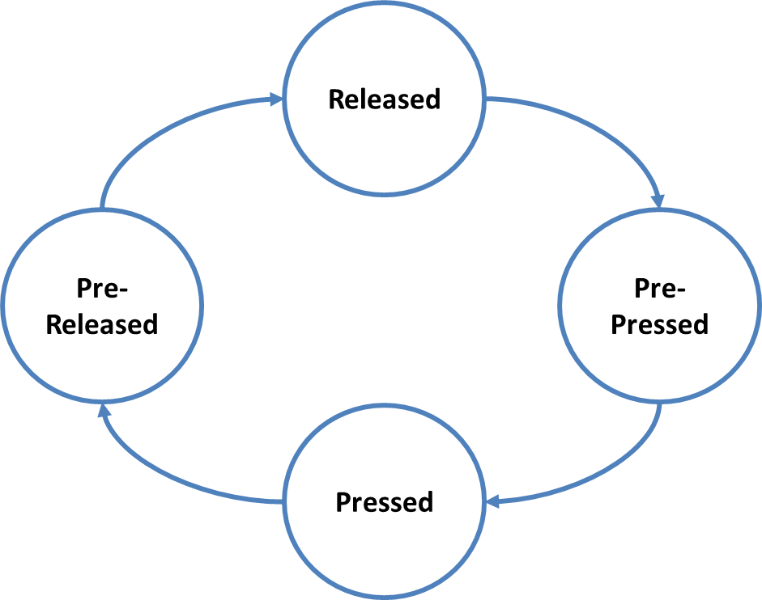
Example: Push Button

Slide 61
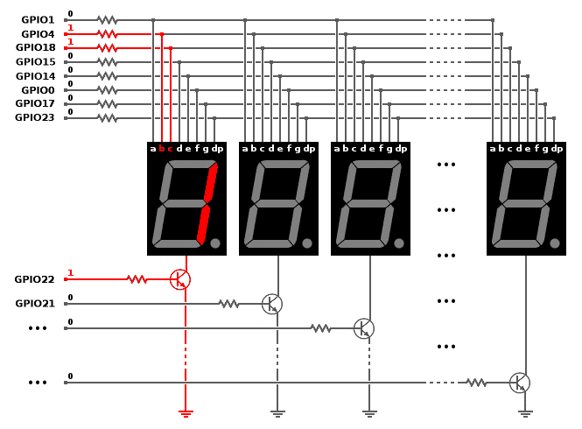
Example: 7 Segment Display

Slide 63
Assignment 3: State Machine
Please, write a complete driver for the following devices using. Each driver should have a state machine.
The devices are:
SW UART
Push button
Seven segment display

Slide 64
Outline
Introduction to SW Design
SW Communication Patterns
State Machine Patterns
Multitasking Forms
The 674 Embedded SW Design Process
Static Design
Dynamic Design
Case Study
Industrial Project

Slide 65
Real-Time System = Correct Functions @Correct Time
They can be:
Hard: Correct time is unnegotiable
Soft: Correct time can be tolerated
Factors determining real-time behavior of a system are:
Determinism (predictability)
Responsiveness

Slide 66

Importance of Real-Time

Slide 67

Multitasking
Executing separate tasks (seemingly) simultaneously

Slide 68
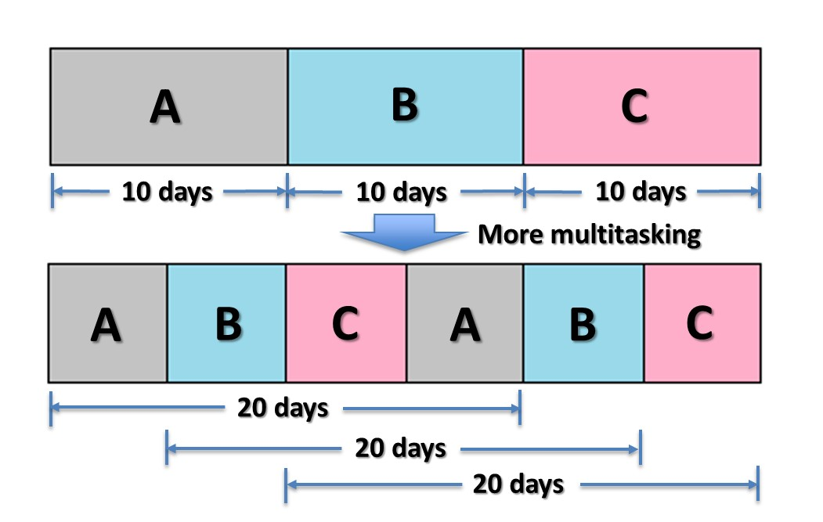
Multitasking Types
Non-preemptive multitasking
Pre-emptive multitasking

Slide 69
Multitasking Requirements
Multitasking
Context Switching
Scheduling
Intertask Interaction

Slide 70
Exercise: Compare Multitasking Requirements from Multitasking Types PoV
 | Preemptive | Non-Preemptive
Context Switching
Scheduling
Intertask Interaction
Multitasking Illusion
Notes:
Context Switching
Context
Overhead
Scheduling
Task level
Interrupt level
Intertask Interaction
Access synchronization

Slide 71
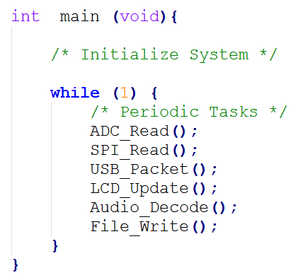
Cyclic Executive - The Super Loop
µController
CPU
IO 1
IO 2
IO N

Slide 72
Multi-Rate Cyclic Executive - The Super Loop
Not all tasks running @ same rate.
Some tasks need higher rate.
Usage of counters
Some tasks need lower rate.
Repetitive task calls

Slide 73
Cyclic Executive - The Super Loop Revisited
Pros
Simple
Minimal HW resources
Highly portable
Cons
Inaccurate timing
High power consumption

Slide 74
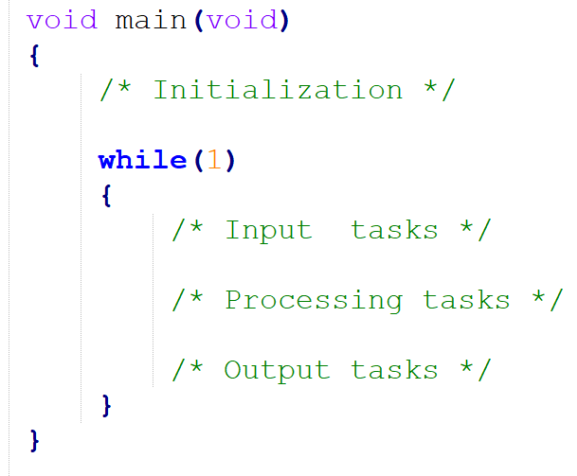
Super Loop as a Design Tool

Slide 75
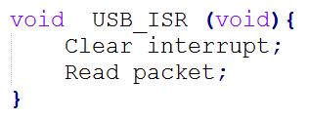
Foreground/Background
µController
CPU
IO 1
IO 2
IO N

Slide 76
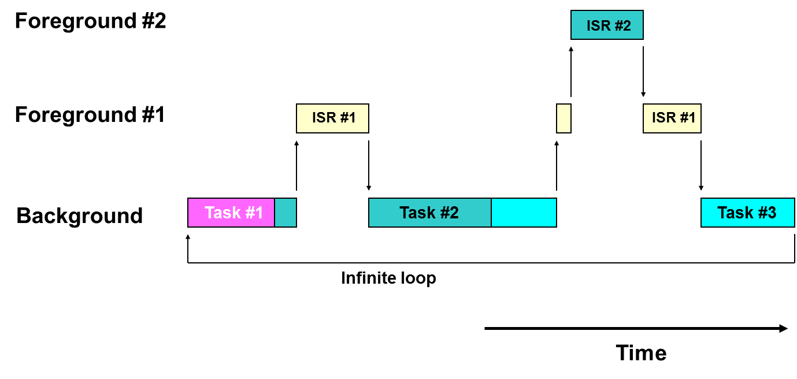
Foreground/Background _{cont’d}

Slide 77
Foreground/Background _{cont’d}
Pros
No upfront cost
Minimal training required
No need to set aside memory resources to accommodate RTOS
Cons
Difficult to ensure that each operation will meet its deadline
High-priority code must be placed in the foreground
Problems can arise when code is maintained by multiple developers
Even in projects with a single developer, expanding the application can prove difficult

Slide 78
RTOS
RT = Correct function @ Correct time
OS = HW + SW manager
RTOS = HW + SW manager that can help us ensure having correct function @ correct time
µController
CPU
RTOS
IO 1
IO 2
IO N

Slide 79
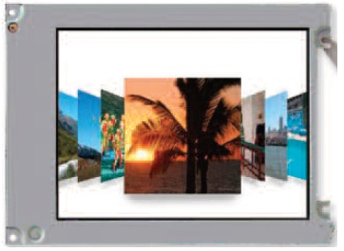

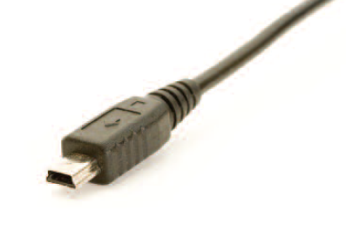

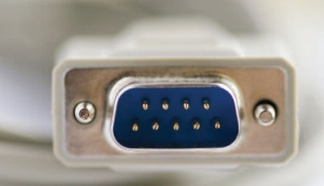
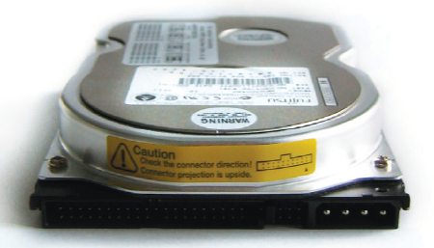
RTOS = Kernel + …
Application
RTOS
File System
GUI
TCP/IP
Kernel
USB
Bluetooth
RS-232
Hardware

Slide 80
Kernel
Objects
Services
Kernel
Scheduler

Slide 81
Scheduler
Algorithm
Dispatcher
Scheduler

Slide 82
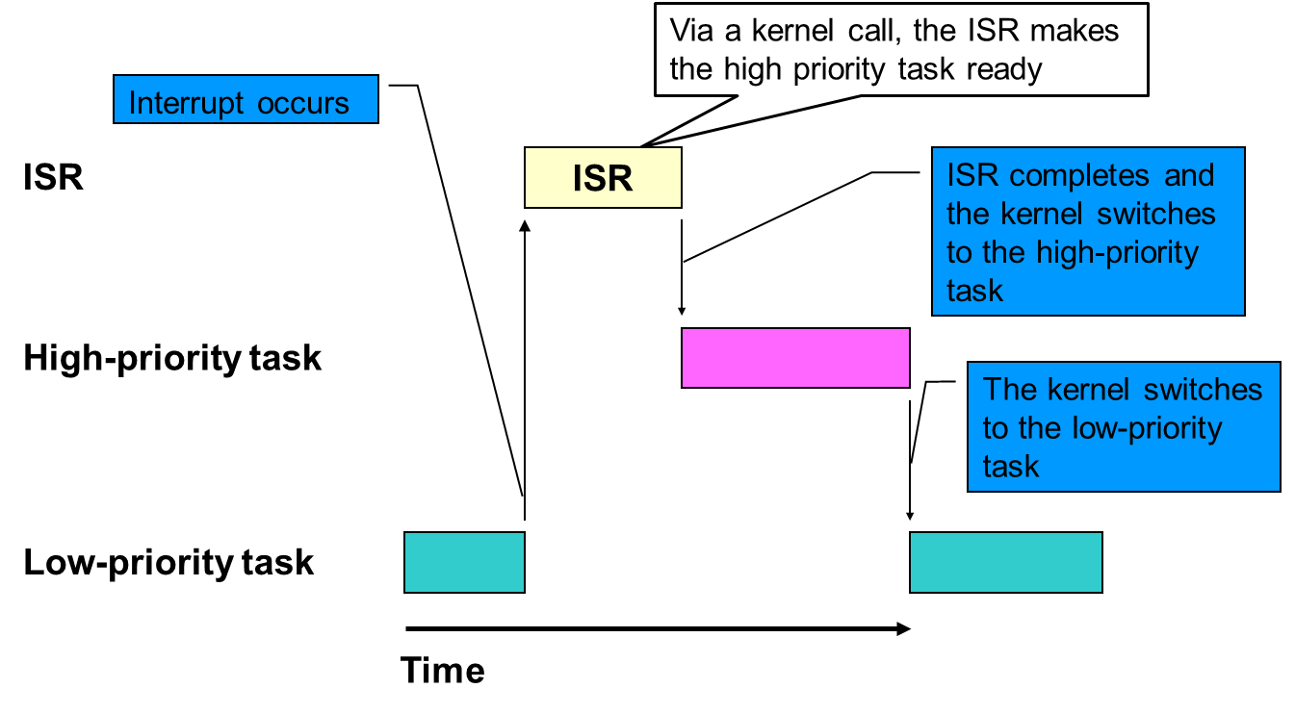
RTOS Scheduling
Interrupt-level scheduling
Task-level scheduling

Slide 83
RTOS Benefits
Developers who use RTOS are freed from implementing a scheduler and related services
Typically applications that incorporate RTOS are much easier to expand
The best RTOS have undergone thorough testing

Slide 84
Exercise: Is it Preemptive or not?
 | Preemptive | Non-Preemptive
Super Loop
Foreground/Background
RTOS

Slide 85
Event Triggered Designs vs. Time Triggered Designs
Event Triggered Design
Time Triggered Design

Slide 86
A Time Triggered System
Co-operative environment that avoids preemption overheads
Workload of a TT system can be ensured to be evenly distributed at design time: in most cases, unlike a system in which multiple interrupts are enabled.
1 µ-Controller == 1 Interrupt
In theory, for a TT architecture we can determine in advance what it will do at every moment of time during its execution.
In practice, TT usually means:
One interrupt source per CPU
The interrupt is often (not always) a “timer tick”
Peripherals are ‘polled’.

Slide 87
Exercise: Answer the Question
To RTOS or not to RTOS?

Slide 88
Assignment 4: Super Loop as a Design Tool
Please select an embedded system and use the super loop as a design tool to identify:
Initialization functions
Tasks

Slide 89
Outline
Introduction to SW Design
SW Communication Patterns
State Machine Patterns
Multitasking Forms
The 674 Embedded SW Design Process
Static Design
Dynamic Design
Case Study
Industrial Project

Slide 90
674 Overview
Could be executed in any order
Could be executed sequentially, overlapping or in parallel
System Design
Detailed Design
Modules remaining
Static Design
Dynamic Design
All modules designed or redesign needed

Slide 91
System Design
Static Design
Dynamic Design
Identify modules and communication between them
Context/block diagram
Super loop
Structure your implementation
3 + 2 x n
.c and .h templates
Detailed design for every module
The 74 part
Classify functions from timing point of view (init, task, ISR or function)
Super loop
The caller
Timing analysis
Timing table
Schedulability check
Timeline

Slide 92
Detailed Design
Understand module under design
Identify public interfaces
Write module.h
Write module.c skeleton
Detail module.c skeleton
Identify private interfaces
Detail private interfaces
Interface = function + data type + #define + variable
Module functions
1 Init
1 or more Update
0 or more set
0 or more get

Slide 93
Outline
Introduction to SW Design
SW Communication Patterns
State Machine Patterns
Multitasking Forms
The 674 Embedded SW Design Process
Static Design
Dynamic Design
Case Study
Industrial Project

Slide 94
Context Diagram
Identify SW under Design physical interfaces
Can be used to illustrate requirements
Physical interfaces are reflected into SW modules
If they are physically the same, they must be grouped into a single SW module.
If they are physically different, they can be grouped into a single SW module.
Number of SW modules ≤ Physical interfaces

Slide 95
Context Diagram Example
Storage
Stop BTN
Screen
Video Player
Play BTN
FFD BTN
RWD BTN
VOL + BTN
Audio Speaker
VOL - BTN

Slide 96
Block Diagram
Identify SW under Design internals
Internal modules
Sub-blocking might be needed.
Tools to help identifying modules:
Context diagram
Expert judgement
Super loop
S.O.L.I.D.
Blocks catalog
Architecture patterns
BTNs
User I/F
Video Decode
Video Out
Screen
File
Audio Decode
Audio Out
Audio Speaker
Storage

Slide 97
S.O.L.I.D. Design Principles
S
Single responsibility
Reason: Fewer responsibilities ➔ Less change probability
O
Open for extension/closed for modification
Reason: Adding functionality == Driving new modules ➔ Avoid breaking old code
L
Liskov substitution
Reason: Hiding data types details + Fixing interfaces ➔ Derived modules can replace base modules
I
D
Interface segregation
Dependency inversion
Hint: Split and separate modules + 1 or more update
Hint: Define new derived modules based on old modules by adding interfaces
Hint: Define enough setters and getters
Reason: More specific interfaces ➔ Less coupling
Hint: Define specific setters and getters
Reason: Focus on abstraction not details ➔ Less coupling and more freedom in location
Hint: Start with what to do not how to do

Slide 98
Blocks Catalog
Boundary modules
Device input
Device output
Device input/output
Proxy
User interaction
Control modules
Coordinator
State-dependent control
Timer/OS
Entity modules
Data wrappers
Data abstraction
Application modules
Algorithm
Service

Slide 99
Structural Architecture Patterns
Layered architecture patterns (strict or flexible)
Control patterns (centralized, distributed-coordinated, distributed-independent, hierarchical or master-slave)
Client/Service patterns (multi-client/single service or multi-client/multi-service)

Slide 100
Communication Architecture Patterns
Communication patterns (synchronized object access, asynchronous messaging, bi-directional asynchronous messaging, bi-directional synchronous messaging, asynchronous messaging with callback, synchronous messaging without a reply, broadcast or subscriber/notification)
Brokering patterns (service registration, broker handle or service discovery)

Slide 101
Needed Files for a Project
Project
µController
Main.h
Board
Port.h
Project
Project.c
Module <<1>>
Module 1.h
Module 1.c
...
Modules
Module <<n>>
Module n.h
Module n.c

Slide 102
XX.h
Guardian
Includes
Public constants
Public data types
Public variables declaration
Public functions prototypes

Slide 103
XX.c
Includes
private constants
Private data types
Private variables definition
Public variables definition
Private functions prototypes
Public functions definitions
Private functions definition

Slide 104
Detailing a Module
Tools to help detailing modules:
The 74 part
Coding
Pseudo coding
Flow charts
State machines

Slide 105
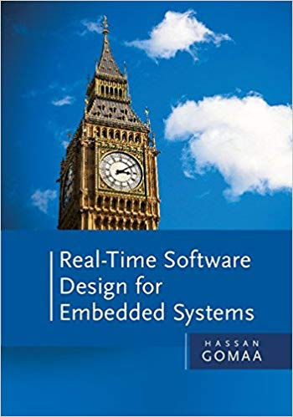
A Good Read

Slide 106
Outline
Introduction to SW Design
SW Communication Patterns
State Machine Patterns
Multitasking Forms
The 674 Embedded SW Design Process
Static Design
Dynamic Design
Case Study
Industrial Project

Slide 107
Timing C/C’s of a Function
E == Execution time
BCET == Best Case Execution Time
WCET == Worst Case Execution Time
B == Blockage
D == Deadline
P == Period
BCET ≤ WCET
B + E ≤ D ≤ P

Slide 108
Timing C/C’s of a Function _{cont’d}
If the functions is not periodic, replace the period with minimum interarrival time.
Worst-case design
No multitasking
Relaxed worst-case design
The first design check
Blockage is considered after integration
Schedulability check
E = D = P
E < D = P
B + E < P

Slide 109
Exercise: Timing C/C’s of a Function
Function Type | E (WCET) | P | B
Initialization
Task
ISR
Function

Slide 110
Food for Thought
Which is more important when designing an RT system?
BCET
WCET
Relation between BCET and WCET

Slide 111
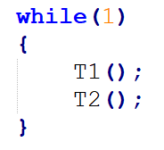
Timing Analysis Example
Task | BCET | WCET | P | B
T1 | 1 | 4 | 3 – 9 | 0
T2 | 2 | 5 | 3 – 9 | 1 – 4

Slide 112
Need for Balancing
BCET/WCET != 1 ➔ Unbalanced
BCET/WCET = 1 ➔ Balanced
Balancing Up (BCET ➔ WCET) | Balancing Down (WCET ➔ BCET)
Add delays | Recoding/Optimization
Time sandwiching | 1 or more update
 | HW accelerators
 | Multiprocessing/multicore
 | Single staging ➔ Multi staging

Slide 113
1 or More Update Examples
Function cohesion between activities
1 Update
Several updates but executed in order
Time cohesion between activities
Several updates
Periodic cohesion
1 Update
Several updates

Slide 114
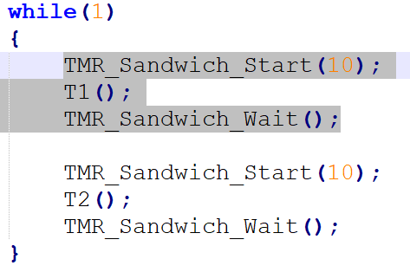
Time Sandwich in Action
WCET ≤ Sandwich Time

Slide 115
What is the Problem?

Slide 116
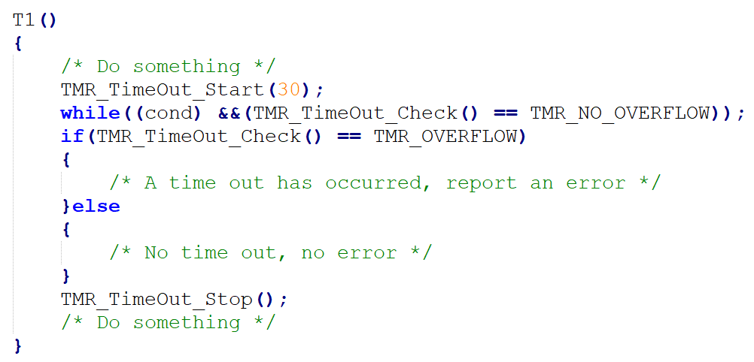
Need for Time Bounding

Slide 117
Time-Triggering
OS_Update @ tick
time

Slide 118
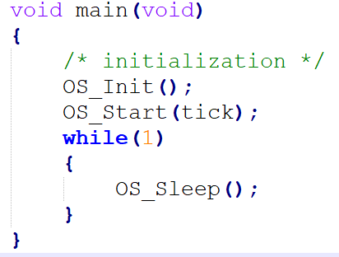
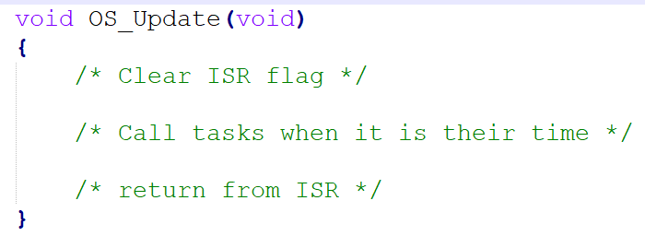
Time-Triggering Implementation Example

Slide 119
Features of Time-Triggering
Can run tasks @ specified rates
ISR’s are easy to manage in high-level language.
Framework to develop embedded systems
Puts the processor “to sleep” between tasks:
To conserve power
To reduce task jitter
Easily portable to other controllers

Slide 120
Timing Analysis for Time-Triggering
Task | Actions | BCET (ms) | WCET(ms) | Period of Action (ms) | Period of task (ms)
T1 | Action 11 Action 12 ... | T1 BCET | T1 WCET | X ms Y ms … | P1 = GCD(X, Y …)
T2 | … | … | … | … | …
... | … | … | … | … | …
Tn | … | … | … | … | …
Tick (ms) |  |  |  |  | = GCD(P1, P2 ...)
Major Cycle (ms) |  |  |  |  | = LCM(P1, P2 ...)

Slide 121
Schedulability Check for Time-Triggering
T4@ 5 ms
T1 Task @ 20 ms
Tick = 5 ms
Major Cycle = 20 ms
Checks needed:
CPU load
B + E < P for every task
SUM(E) in a tick < tick
T2 @ 20 ms
T3 Task @ 20 ms
time

Slide 122
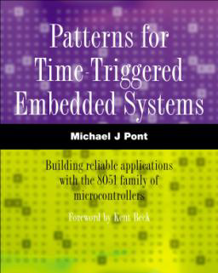
Multi Staging is Crucial for Time-Triggering
Single staging ➔ All needed processing is done on a single call
Multi staging ➔ All needed processing is done on several calls
In multi staging, you may need to consider:
P < D

Slide 123
Multi Staging Examples

Slide 124
Jitter
Relaxation in timing
Jitter = 0 ➔ Hard RT
Jitter != 0 ➔ Soft RT
Not all functions need to have 0 jitter

Slide 125
Jitter Elimination in Time-Triggering
Changing task order
Using time sandwiches
time
time

Slide 126
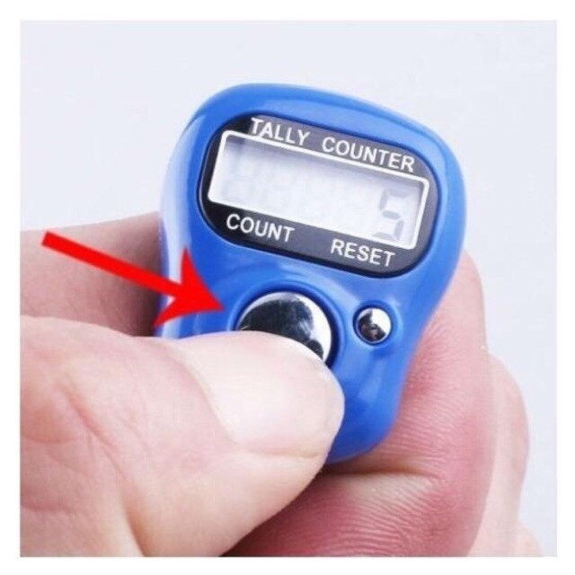
Sebha Example

Slide 127
Sebha: Static Architecture
Sebha
+
H
SW
OS
DISP
Scheduling
T
SSD
R
U
Counter
SW States
Sebha Count

Slide 128
Sebha: Detailed Design
SW
SW_Init
SW_Update
SW_GetState
OS
OS_Init
OS_update
OS_Sleep
CTR
CTR_Init
CTR_Update
CTR_GetCount
DISP
DISP_Init
DISP_Update
SSD
SSD_Init
SSD_Update
SSD_SetSymbol
SSD_GetSymbol
SSD_SetState
SSD_GetState

Slide 129
Sebha: Timing Analysis
Task | Actions | BCET (ms) | WCET(ms) | Period of Action (ms) | Period of task (ms)
SW | Update samples Update SW state | ~0 ~0 | ~0 ~0 | 20 20 | 20
CTR | Update CTR | ~0 | ~0 | 20 | 20
DISP | Update display | ~0 | ~0 | 20 | 20
SSD | Update SSD | ~0 | ~0 | 5 | 5
Tick (ms) |  |  |  |  | 5
Major Cycle (ms) |  |  |  |  | 20

Slide 130
Sebha: Schedulability Check
SSD Task @ 5 ms
Counter Task @ 20 ms
SW Task @ 20 ms
DISP Task @ 20 ms
time
time

Slide 131
Outline
Introduction to SW Design
SW Communication Patterns
State Machine Patterns
Multitasking Forms
The 674 Embedded SW Design Process
Static Design
Dynamic Design
Case Study
Industrial Project

Slide 132
Digital Clock

Slide 133
Digital Clock Context Diagram
Digital Clock
Hours Tens SSD
- Button
Hours Units SSD
Set Button
Minutes Tens SSD
+ Button
Minutes Units SSD
SSD = Seven Segment Display

Slide 134
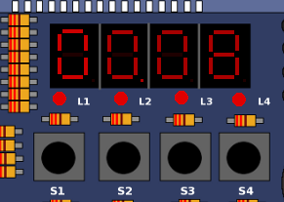
HW Interfaces
System Interface | Board Interface
- Button | S1
Set Button | S2
+ Button | S3
Hours Tens | SSD above L1
Hours Units | SSD above L2
Minutes Tens | SSD above L3
Minutes Units | SSD above L4
Development board is board # 3 in PicSimLab version 5

Slide 135
Development Environment
Board: Board 3 in PicSimLab version 5
C is the programming language.
No assembly used
SDCC, gputils and codeblock as toolchain .

Slide 136
Digital Clock States
Normal
Set Hours
Set Minutes

Slide 137
Normal State
Default mode
System should display hours and minutes.
Dot in the “Hours Units” SSD should blink every second.
All SSDs should not blink.
If “Set Button” is released after 200 ms press, the digital clock should go to “Set Hours” state.
“- Button” and “+ Button” are ignored.

Slide 138
Set Hours State
System should blink the hours SSDs every second.
Dot in the “Hours Units” SSD should be off.
Minutes SSDs should not blink.
If “Set Button” is released after 200 ms press, the digital clock should go to “Set Minutes” state.
If “- Button” is pressed, the hours field should decrement by one once.
Holding the “- Button” pressed does not count.
If hours = 00, hours should be hours = 23.
If “+ Button” is pressed, the hours field should increment by one once.
Holding the “+ Button” pressed does not count.
If hours = 23, hours should be hours = 00.

Slide 139
Set Minutes State
System should blink the minutes SSDs every second.
Dot in the “Hours Units” SSD should be off.
Hours SSDs should not blink.
If “Set Button” is released after 200 ms press, the digital clock should go to “Normal” state.
If “- Button” is pressed, the minutes field should decrement by one once.
Holding the “- Button” pressed does not count.
If minutes = 00, minutes should be minutes = 59.
If “+ Button” is pressed, the minutes field should increment by one once.
Holding the “+ Button” pressed does not count.
If minutes = 59, hours should be minutes = 00.

Slide 140
Outline
Introduction to SW Design
SW Communication Patterns
State Machine Patterns
Multitasking Forms
The 674 Embedded SW Design Process
Static Design
Dynamic Design
Case Study
Industrial Project

Slide 141
Context Diagram
+
Mot
3 x SSD
-
P
P Led

Slide 142
Motor Speed Control
If (+) is pre=pressed & speed is not max, speed increases by 1 step
If (-) is pre=pressed & speed is not min, speed decreases by 1 step
If(P) is pressed & press time == 30 seconds & speed is not min, speed decreases by 1 step.
+ is prepressed
+ is prepressed
Min
Mid
Max
- is prepressed OR P is pressed for 30 secs
- is prepressed OR P is pressed for 30 secs

Slide 143
Display
P Led is ON if P is pressed
3 x SSD indicate speed level
High Speed
Mid Speed
Low Speed

Slide 144
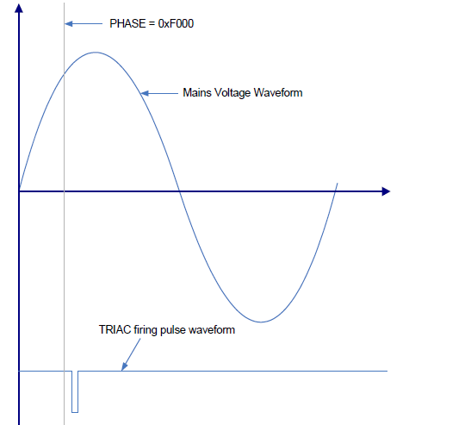
Motor Control
Firing @ 10 ms
Firing pulse 100 micro seconds
Min Speed ➔ 140 degrees
Mid Speed ➔ 90 degrees
Max Speed ➔ 10 degrees
Soft switching @ 40 ms
1 degree change every 40 ms
Startup: 170 ➔ 90
Speed change
Harmonic Reduction @ 20 ms
Delta angle = 5 degrees
Kurtz Technique

